Slide 1
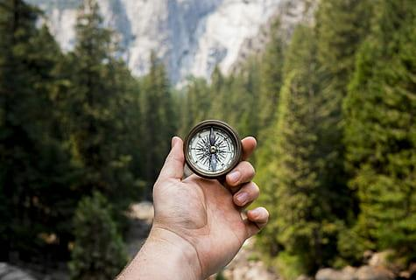
Marco Polo 🐼
Ctrl+Alt+Elite:
Kevin Dimayuga
Eissa Purnell
Jacob Ontiveros
Notes:
Eissa

Slide 2
Elevator Pitch
How many times have you lost something when you’re out? Too many to count I’m sure. Maybe it was your wallet, an umbrella, or a book you loved, I’m sure you never thought you’d see it again. We wanted to change that.
Marco Polo is a lost and found application that helps users reconnect with items that they may have lost. Users can create an account and instantly be taken to a list of items waiting to be returned to their owners.
To make things easier users can see not only the item that is lost but the location where it was lost.
Finally, there is a way for users to post lost items so that you are able to retrieve lost possessions that you never thought you would see again.
Notes:
Eissa

Slide 3


Motivation for Development
We wanted to create a lost and found application that was simple and allowed users to be able to easily find what they ended up losing and contact the individual who found it so they can retrieve it.
Notes:
Jacob

Slide 4
User Story
As A USER
I WANT to be able to utilize the Marco Polo application
SO THAT I can search for items that I lost and report lost items that I have found
Notes:
Jacob

Slide 5
Process
Technologies used:
Express.js, Node.js, React, GraphQL, Mongoose, MongoDB, Heroku, JWT authentication, Apollo Server, Vite, Bcrypt, Nodemon, Concurrently
Breakdown of tasks and roles:
Kevin - Resolvers, Typedefs, Components, CSS
Eissa - Queries, Mutations, Auth.js (in server + client), server.js
Jacob - Seed Data and Models on server side. Components, CSS styling on client side
Together -
After completing our own tasks and roles, we debugged, refactored and fixed our code as much as possible to get the app to Minimum Viable Product (MVP)
Fixing the app.jsx and main.jsx
Refactoring the components of our app
Notes:
Jacob

Slide 6
Process (cont’d)
Challenges:
A plethora of errors
Database data undefined
Fixing the routes to each page
Making sure our backend and frontend were connected
Rendering the item list to the page
Successes:
Successfully connecting the backend to the frontend
Setting up the routes to each page of our lost and found app
Notes:
Kevin

Slide 7
Marco Polo Demo
Notes:
Kevin

Slide 8

Directions for Future Development
Ability to allow users to search for multiple items
Implement a “Filter” feature to allow users to easily search for lost item
Add a “Users Profile” page that displays the users lost items history
Allow users to add a picture of their lost item within their profile
Google Maps: to allow users to see the exact location of the found items
Allow users to click on each “Item” box to view a detailed description of the lost item
Fix “Search for Item” and “Report Item” functions
CTRL+ALT+ELITE has agreed upon to continue working together on this project after graduation 🐼
Notes:
Eissa

Slide 9

Links to Content
GitHub: https://github.com/kevindimayuga/marco-polo
Heroku Deployment: https://marco-polo-a85aba4e1513.herokuapp.com/
Notes:
Eissa

